Slide 1




Preventing credential theft before it happens
IntrusionX Second Edition
PhishShield AI
DIGITAL-DETECTIVES
Cybersecurity + AI
IntrusionX SE | Cyberonites

Slide 2
PhishShield AI is a browser extension that detects phishing websites in real time
Uses a hybrid approach:
Machine Learning (pattern detection)
Behavioral analysis (page activity)
Risk scoring (decision system)
PhishShield AI is a browser extension that detects phishing websites in real time
Uses a hybrid approach:
Machine Learning (pattern detection)
Behavioral analysis (page activity)
Risk scoring (decision system)
Detects phishing before user enters credentials
Avoids false positives using context-aware scoring
Provides Explainable AI (why flagged)
DIGITAL-DETECTIVES
PROPOSED SOLUTION:
How it solves the problem
Detects phishing before user enters credentials
Avoids false positives using context-aware scoring
Provides Explainable AI (why flagged)
Innovation & Uniqueness
Hybrid AI system (ML + rules + behavior)
Real-time detection inside browser
Transparent decision-making (user trust)
IntrusionX SE | Cyberonites

Slide 3
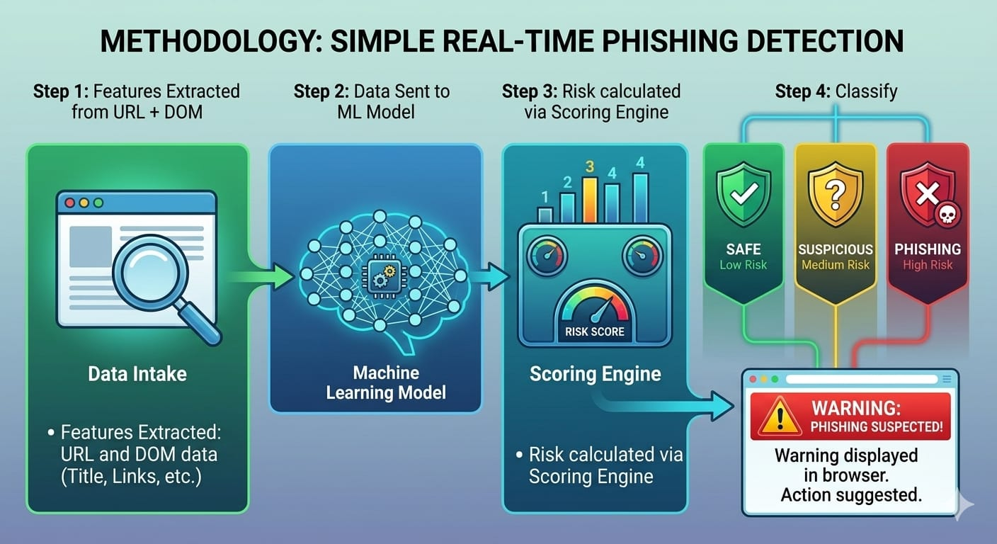
DIGITAL-DETECTIVES
TECHNICAL APPROACH
Technologies Used
Frontend: HTML, CSS, JavaScript
Extension: Chrome Extension APIs
Backend: Python (Flask)
ML Model: Random Forest (Scikit-learn)
Methodology
Extract features from URL + DOM
Send data to ML model
Calculate risk using scoring engine
Classify:
  Safe / Suspicious / Phishing
Display real-time warning popup
IntrusionX SE | Cyberonites

Slide 4
1.Feasibility
Lightweight Chrome extension → easy deployment
Works in real-time without heavy resources
ML model already trained and integrated
2.Challenges
False positives on login pages
Limited feature extraction
Dynamic website behavior
3.Solutions
Introduced weighted risk scoring
Added DOM-based feature extraction
Hybrid ML + rule-based system
DIGITAL-DETECTIVES
FEASIBILITY AND VIABILITY
IntrusionX SE | Cyberonites

Slide 5
Impact
Prevents credential theft in real time
Protects users from phishing attacks
Improves user awareness with explanations
Benefits
✔ High accuracy with reduced false positives
✔ Explainable AI builds trust
✔ Scalable to millions of users
✔ Applicable for students, enterprises, browsers
Prevents credential theft in real time
Protects users from phishing attacks
Improves user awareness with explanations
DIGITAL-DETECTIVES
IMPACT AND BENEFITS
IntrusionX SE | Cyberonites

Slide 6
DIGITAL-DETECTIVES
RESEARCH AND REFERENCES
UCI Machine Learning Repository
Phishing Websites Dataset (used for model training)
PhishTank (Open Phishing Database)
Real-world phishing URLs for validation and testing
Scikit-learn Documentation
Used for implementing the Random Forest ML model
Google Safe Browsing (Concept Reference)
Inspiration for real-time phishing detection approach
OWASP Phishing Prevention Guidelines
Security best practices for detecting phishing attacks
  “System designed using real-world cybersecurity practices and datasets.”
IntrusionX SE | Cyberonites

